Slide 1
Welcome to your studies at JGU
1 –INTRODUCTION
2 –HOW DO I FIND MY COURSES?
3 –WHICH COURSES CAN I CHOOSE?
4 – GUTENBERG INTERNATIONAL SCHOOL
5 –HOW DO I REGISTER FOR COURSES?

Slide 2
1 – INTRODUCTION
YOU HAVE MANY QUESTIONS…
Who can help answer all my questions?
Where can I get advice?
Which courses can I attend at JGU as an exchange student?
How can I find courses in the JGU course catalogue?
Which courses are taught in English or in another foreign language?
How can I register for courses and when is the deadline?
Johannes Gutenberg Universität Mainz

Slide 3
…WE HAVE THE ANSWERS! ☺
GIS SERVICES
Give an overview of your exchange semester at JGU
Answer general questions about the course registration process:
How do I register?
Where do I find the registration form?
Problems with downloading the form?
How do I fill in the form?
Johannes Gutenberg Universität Mainz

Slide 4
…WE HAVE THE ANSWERS! ☺
DEPARTMENTAL ACADEMIC ADVISORS & ERASMUS DEPARTMENTAL COORDINATORS
Answer your academic questions
Give you advice on your choice of courses and the course contents:
How many ECTS?
Can I select this specific course?
Which courses are right for me?
What language skills do I need for the course?
Sign registration form
Johannes Gutenberg Universität Mainz

Slide 5
STRUCTURE OF JGU
Central Administration
GIS Services / International Office
Student Services
International Language Center etc.
Faculty – Department / Institute – Subject
Ten faculties
Mainz School of Music
Mainz Academy of Fine Arts
Faculty 06 is located in Germersheim, approximately
100 km away from Mainz.
Johannes Gutenberg Universität Mainz

Slide 6
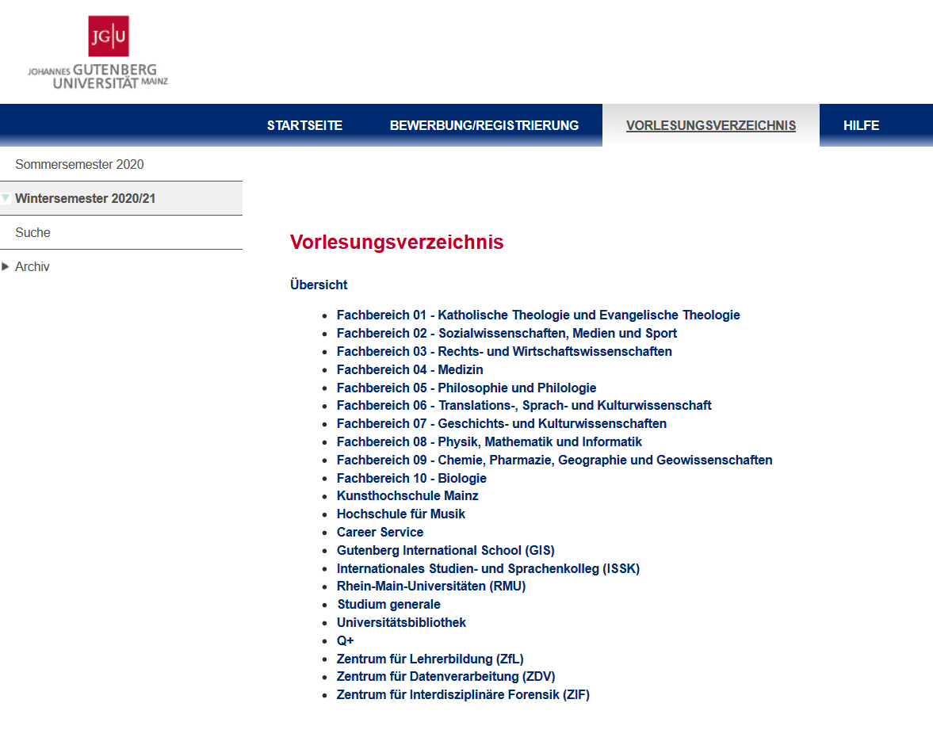
2 – HOW DO I FIND MY COURSES IN ?
1.
https://jogustine.uni-mainz.de
Select “Course Catalogue”
Select Semester
Select Faculty
2.
3.
= all courses offered by all departments and institutes
No login necessary!
You can change languages
in the top right-hand corner.
Johannes Gutenberg Universität Mainz

Slide 7
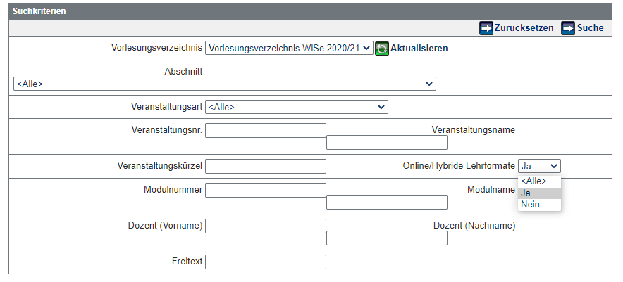
2- HOW DO I FIND MY COURSES IN ?
Option A: You can use the SEARCH function in JOGU-StINe to search for specific courses:
No login necessary!
3. Search
1. Select faculty or other search criteria
2. Show digital offers
Johannes Gutenberg Universität Mainz
Notes:
Bitte englische Variante erstellen inkl eng screenshot

Slide 8
Option B: You can also click through to specific courses:
https://jogustine.uni-mainz.de
1. Select "Course catalogue"
2. Select semester
3. Select Faculty
4. Select subject (Fach)
5. Select type of course
2.
1.
3.
No login necessary!
Johannes Gutenberg Universität Mainz

Slide 9
= Result: List of courses available
You can find further details in the course descriptions by clicking on the course
All digital events are marked with
Johannes Gutenberg Universität Mainz

Slide 10
6. Selection of a course:
Course number
Course title
Course description:
a.
b.
c.
Place, time, dates
Lecturer
Language of instruction
Contents
Important information etc.
Please note that sometimes the
course description is more detailed
in the German version.
Johannes Gutenberg Universität Mainz

Slide 11
3 – WHICH COURSES CAN I CHOOSE?
COURSES AT JGU FOR EXCHANGE STUDENTS
Courses from all fields of studies in almost all departments
The academic advisors will tell you if a specific course is open to you
Additional interdisciplinary course offers: Studium Generale
Computer Skills (ZDV – Zentrum für Datenverarbeitung)
„Schreibwerkstatt“ (Only via: www.schreibwerkstatt.uni-mainz.de)
Special offers by the Gutenberg International School
www.international-office.uni-mainz.de/exchange/gis/
Johannes Gutenberg Universität Mainz

Slide 12
***GUTENBERG INTERNATIONAL SCHOOL***
A SPECIAL COURSE OFFER FOR EXCHANGE STUDENTS
You want to...
...improve your German skills?
...earn credits?
...expand your horizon?
Just have a look at what the Gutenberg International School has in store for you!
You can find the current course offers for the winter semester 2021/22 here: https://www.international-office.uni-mainz.de/exchange/gis/
Johannes Gutenberg Universität Mainz

Slide 13
GUTENBERG INTERNATIONAL SCHOOL
***GUTENBERG INTERNATIONAL SCHOOL***
Course Offer in History & Culture (in English)
Regional & German History
North American & British History
History of „Human Rights“
Cultural Geography
Philosophical Topics
Techniques of Academic Work in Germany
Johannes Gutenberg Universität Mainz
Notes:
National History: Visual History of Germany since the 20th century
Regional History: Life and Death in the Rhine-Main Area. Man and Nature between Migrations and Settlements, from the Beginning of Mankind until the Time of Charlemagne (Bilingual German – English)
Regional Film History: about movies and TV shows shot in Rhineland-Palatinate and the media location Mainz amongst other things
Lecture Series in History & Culture: Under Construction: young scientists from the faculty of history and cultural studies present their current projects
Cultural Geography: from master program “Globalisation, Media and Culture“ – open also to higher BA students – very eager to have exchange students in their classes for new perspectives from all over the world

Slide 14
GUTENBERG INTERNATIONAL SCHOOL
***GUTENBERG INTERNATIONAL SCHOOL***
Course Offer in Social Sciences & Society (in English)
The Social Scientist’s View of Germany
Beyond Clichés – Intercultural Training
Media & Politics in Israel (Israel professorship)
Globalization & Media
Innovation and Sociology
ICON Mainz: International Students' Conference
Techniques of Academic Work in Germany
Johannes Gutenberg Universität Mainz
Notes:
Media & Politics in Israel: Israel professorship next semester also with courses on these topics
Globalisation & Media (with regards to Geography): see chart before
Beyond Clichés: Beyond Clichés is an exceptional and cross-disciplinary course where you develop your skills in successful intercultural communication and experience Mainz as an international team. You get to know fellow students from Mainz and abroad.
Technology and Innovation Sociology & Social Simulation: several courses in these areas open to exchange students

Slide 15
***GUTENBERG INTERNATIONAL SCHOOL***
***GERMAN HISTORY & CULTURE (Intermediate German level)***
Conversation Courses (talk about current topics in Germany)
For registration, please write an email with your German level to
gis@international.uni-mainz.de
Reading Course(s) of German Literature
Course on German Grammar
(here: B2 level or better recommended)
German History: Dying – being dead – being remembered
Sepulchral culture in the 20th and 21st century
Johannes Gutenberg Universität Mainz

Slide 16
GUTENBERG INTERNATIONAL SCHOOL
***GUTENBERG INTERNATIONAL SCHOOL***
***GERMAN COURSES ISSK***
Course Offers
Language Courses from A1.1 to C1.2
Sessions on 2 days per week with a total of 6 academic hours (45 minutes)
Additional courses on B1-C2 level with 6 academic hours
(Grammar & Communication)
You will obtain ECTS credits for every successfully completed course
Occupational German for Academics (Level B2.1 & B2.2)
Registration from September 30th to October 12th 2021
Johannes Gutenberg Universität Mainz
Notes:
Occupational German for Academics: for students who consider to work in Germany in the future

Slide 17
***GUTENBERG INTERNATIONAL SCHOOL***
***GERMAN COURSES ISSK***
Registration procedure
1. Absolute Beginners (You have no or little German proficiency)
or
2. Students with A1-C1 certificates (You have an official certificate)
Online registration – Information see here:
https://www.issk.uni-mainz.de/deutsch-als-fremdsprache/studienbegleitende-deutschangebote/anmeldung-fuer-die-deutschkurse/
You DO NOT belong to the groups above Complete the online placement test
!!!Please fill out online application afterwards!!!
Johannes Gutenberg Universität Mainz

Slide 18
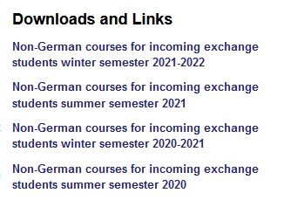
***GUTENBERG INTERNATIONAL SCHOOL***
Further Service of the Gutenberg International School
List of all non-German taught courses which are open to you
(incl. Online courses at Campus Germersheim)
www.international.uni-mainz.de/exchange/gis/
(download section)
Courses of the Rhine-Main University Alliance (RMU)
You will receive more information on this via e-mail!
Further Recommendation
Johannes Gutenberg Universität Mainz
Notes:
ICON: Managing an event like a huge academic conference

Slide 19
4 – HOW DO I REGISTER FOR COURSES?
WHAT DO I NEED FOR THE REGISTRATION?
w
Computer and printer
Course catalogue JOGU-StINe (without Login)
Registration form
List of academic advisors
Personal advice by the academic advisors
Johannes Gutenberg Universität Mainz

Slide 20
WHAT DO I NEED TO CONSIDER? „DO‘S & DON‘TS“
DO’S:
LEARNING AGREEMENT: The selection of courses should resemble the courses selected in
the Learning Agreement
ECTS
If possible, half of the courses should be selected from the major subject (see admission letter)
DON‘T‘S:
Courses offered by the School of Music, the Academy of Fine Arts and Medicine (except for non
German courses) are unfortunately not open for exchange students from other subjects
Johannes Gutenberg Universität Mainz

Slide 21
WHEN IS THE DEADLINE TO REGISTER?
The deadlines for the registration are determined by the different departments
There is no general registration deadline
Ideally you should know which courses you want to attend at the beginning of the lecture period or at the end of the first week of the lecture period
Johannes Gutenberg Universität Mainz

Slide 22
COURSE REGISTRATION: EXCEPTION 1: LAW
To register for Law courses you need a special form
You get it from the academic advisor for exchange students Mr. Klaus Mayer
For office hours and more information please see the information sheet
of the Auslandsbüro Jura
Johannes Gutenberg Universität Mainz

Slide 23
COURSE REGISTRATION: EXCEPTION 2: ECONOMICS
→ Course registration for Economic courses for students enrolled in Economics
online via JOGU-StINe
→ TAN list required (you already got it when you enrolled)
Questions regarding the selection of courses can be answered by the ERASMUS Office erasmus-wiwi@uni-mainz.de or the International Office (non-ERASMUS) fb03-international@uni-mainz.de of the Gutenberg School of Management and Economics.
Johannes Gutenberg Universität Mainz

Slide 24
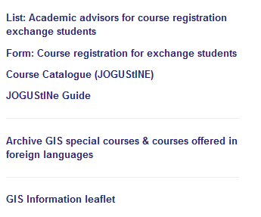
REGISTRATION STEP 1:
DOWNLOAD AND FILL IN THE REGISTRATION FORM
Where do I find the form „Course registration for exchange students“ ?
→ In the „Downloads and Links“section on
www.international-office.uni-mainz.de/exchange/gis/
→ Open the document and fill it out
Johannes Gutenberg Universität Mainz

Slide 25
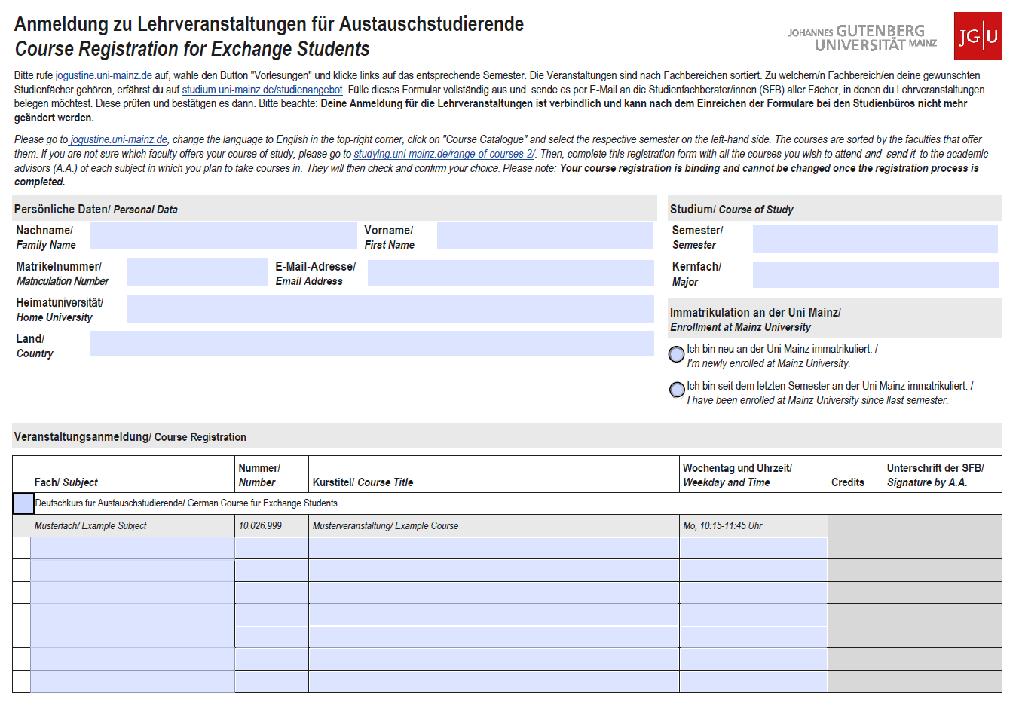
Fill in the form
Personal data
Major subject
“I‘m newly enrolled at JGU”
(1)
(2)
(3)
Johannes Gutenberg Universität Mainz
Notes:
NEUER SCREENSHOT UND STIFT_ICON INFOS AUS GUIDE

Slide 26
Fill in the form and print it out
(4) Courses
(5) Once you’ve completed the form, save it and send it via e-mail to your departmental coordinator.
(4)
Johannes Gutenberg Universität Mainz
Notes:
NEUER SCREENSHOT UND STIFT_ICON INFOS AUS GUIDE

Slide 27
REGISTRATION STEP 2:
PERSONAL CONSULTATION WITH YOUR ACADEMIC ADVISOR
1. Check the list “Academic advisors for course registration exchange students“ to find your contact person in the department(s)
2. Write an email to the relevant academic advisor with your filled out form attached and, if need be, arrange personal consultation with him or her
Where do I find the list?
In the „Downloads and Links“ section on
www.international-office.uni-mainz.de/exchange/gis/
Johannes Gutenberg Universität Mainz

